Slide 1
Stock Trading using RL Agents
Presented by:
Gulnara Timokhina,
Mirsaeid Abolghasemi
Poornapragna Vadiraj
Varun Bhaseen

Slide 2
Introduction
Purpose
The Primary purpose of this project is to create a set of RL models which can execute stock trading by deciding whether to buy, sell or hold stocks based on maximizing the asset value (total profit)
Objectives
Create a Custom Trading Environment using gym Env class and Stable baseline library
Run multiple RL algorithms (A2C, DQN, TRPO and PPO)
Evaluate the performance of the Models

Slide 3
The RL Algorithms used
RL Algorithm | Model-Free or Model-Based | Value-Based or Policy Based | On-Policy or Off-Policy
DQN | model-free | Value-based for a given state we calculate the Q value for every action in the action space and we pick the max value and its corresponding action ( so choosing actions depends on the Q value ) | off-policy Off-policy learning allows the use of older samples (collected using the older policies) in the calculation. To update the policy, experiences are sampled from a buffer which comprises experiences/interactions that are collected from its own predecessor policies. This improves sample efficiency since we don’t need to recollect samples whenever a policy is changed.
TRPO | model-based | Policy-Based in policy-based methods, we directly learn our policy function π without worrying about a value function. | On-Policy Typically the experiences are collected using the latest learned policy, and then using that experience to improve the policy.
PPO | model-based | Policy-Based in policy-based methods, we directly learn our policy function π without worrying about a value function. | On-Policy Typically the experiences are collected using the latest learned policy, and then using that experience to improve the policy.
A2C | Model-free | Both | On-Policy

Slide 4
Methodology
Create Trading Environment
Data Pipeline
Data Preprocessing
Adding Technical Indicator
Remove null or na values
Standardize features
Split the data using date
Build RL Agents
Train the Agents
DQN
PPO
A2C
TRPO
Evaluate Performance
Cumulative returns
Daily returns
Sharpe ratio
Percent change in each closing day
Save the Model
Gym Environment class
Stable Baseline
Yahoo Finance API
Training Data
Trading Data
On Training dataset and evaluate the performance
Save the model as a H5 file to be used in any web application

Slide 5
Deep Q Learning
Using DQN to manage Stock Trading

Slide 6
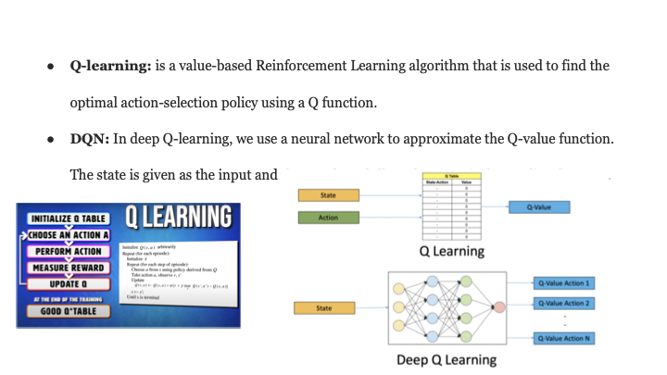

Slide 7
DQN
Environment
the environment will be the trading environment
Observation
Using price as an observation
Default Stock features
Action
Buy
Sell
At each time step, the environment will pass the current state to the agent
Hold
Agent
Stock Ticker = Apple [‘Appl’]
Reward is Total Profit achieved

Slide 8
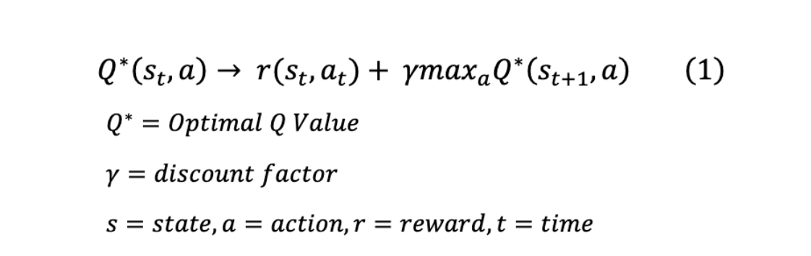
Equations for DQN
DQN is an extension of Q-learning algorithm that uses a neural network to represent the Q value.
Like supervised (deep) learning, in DQN we train a neural network and try to minimize a loss function.
A DQN agent choose an action according to the greedy policy - maximizing the Q* function

Slide 9
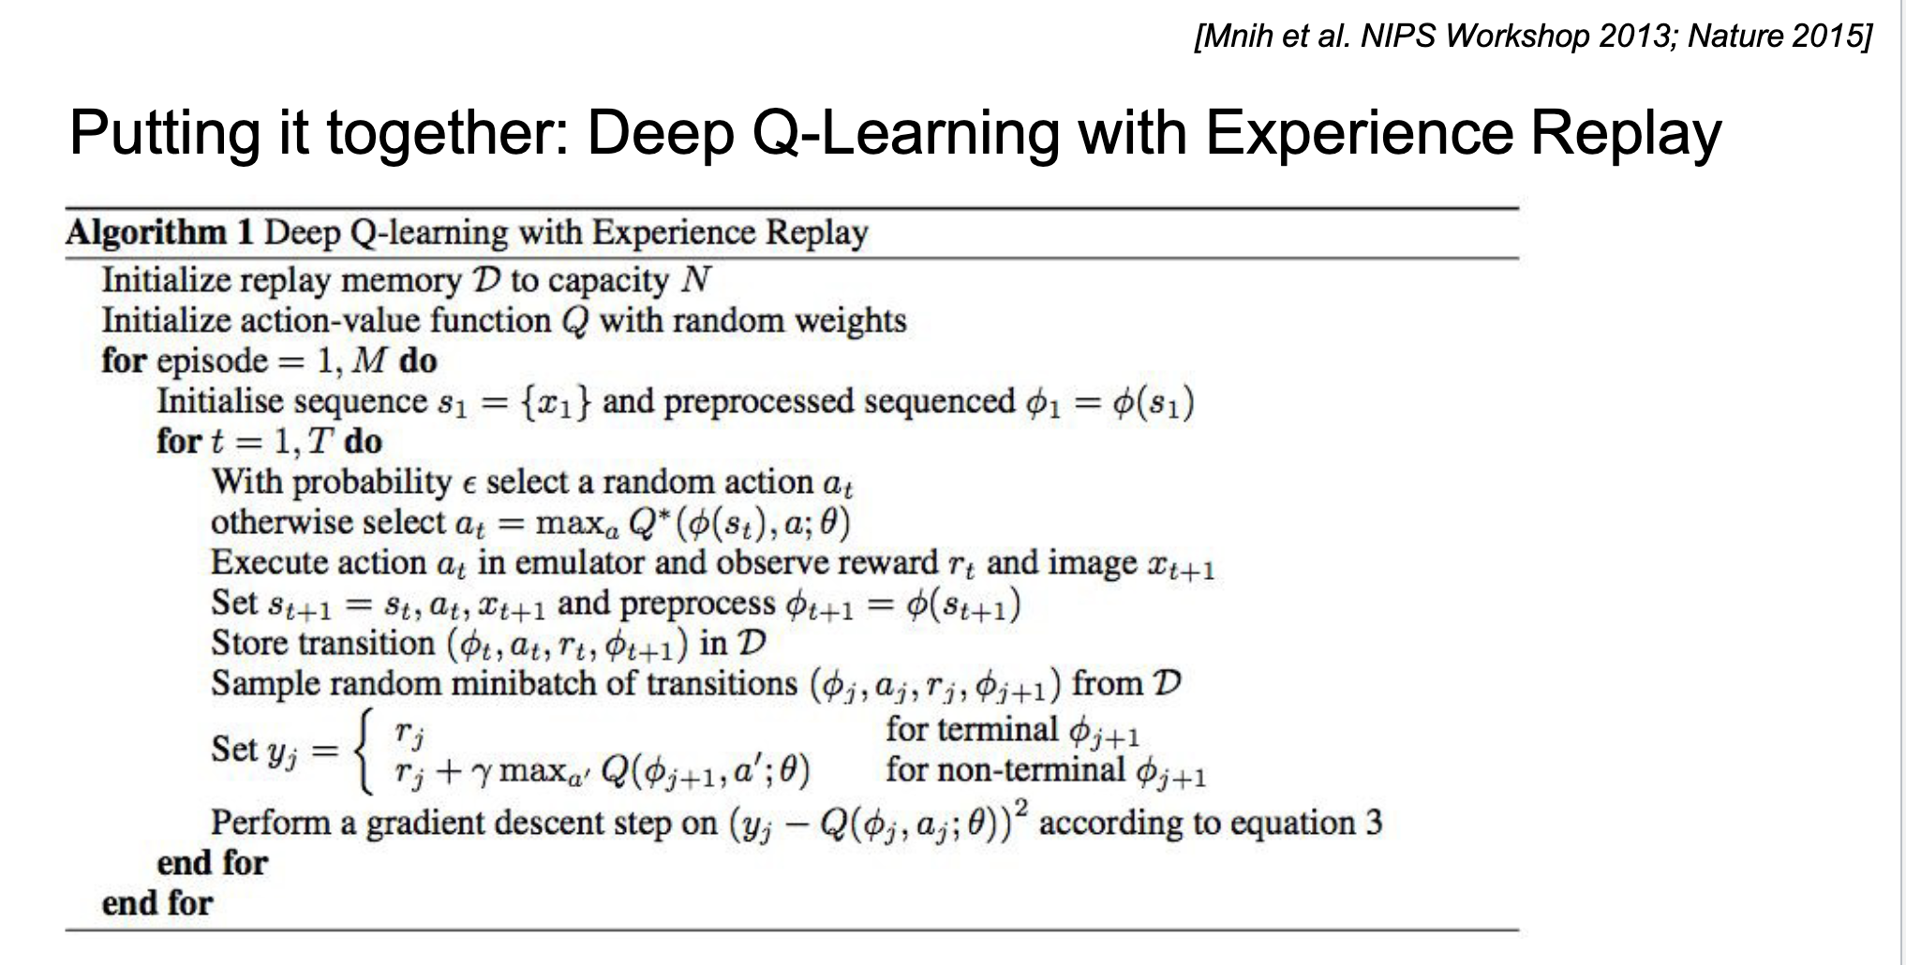
Deep Q-learning takes advantage of experience replay
which is when an agent learns from a batch of experience.

Slide 10
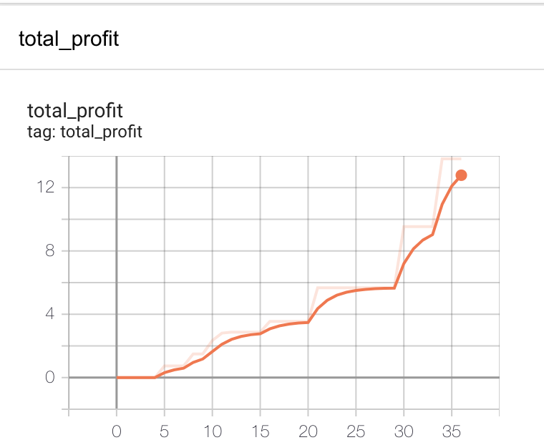
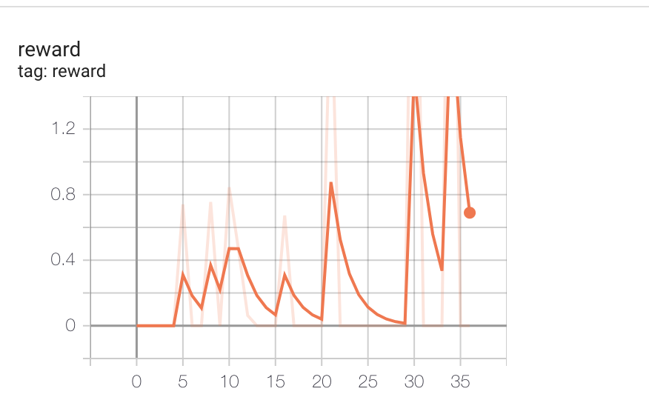
DQN Performance output

Slide 11
Actor Critic
Using Actor Critic to manage Stock trading

Slide 12
Actor-Critic
Environment
At each time step, the environment will pass the current state to the agent.
Observation
N past bars(windows), where each has open, high, low, and close prices
Buy
Reward
the profit earned when action=sell
current price of the stock - buy price of the stock
In our case the state is predicted future price, how long has the stock been held, and the profit/loss if I were to sell the stock today
An indication that the share was bought some time ago
Profit or loss that we currently have from our current position (the share bought)
Action Space
Hold
Sell
Datapoints
Stock Ticker = Apple [‘Appl’]

Slide 13
Actor-Critic contd..
The Actor is the policy-based model: which takes the Stock Price and gives out a probability distribution of actions: Hold, Buy, or Sell.
The Critic is a DQN which takes the Stock Price and an Action given by the Actor and computes the Q value. The critic is trained to maximize the Q Value. The Q value is used by the Actor to Improve probabilities of better actions

Slide 14
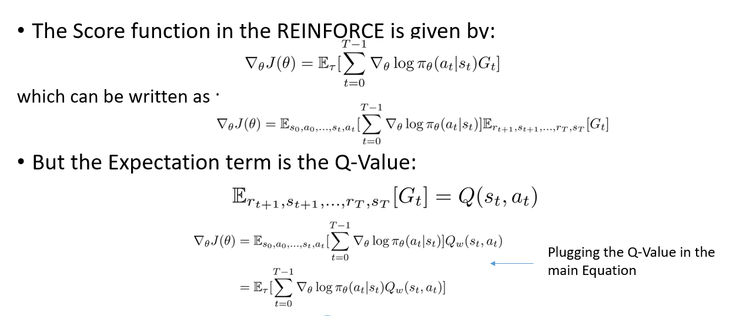
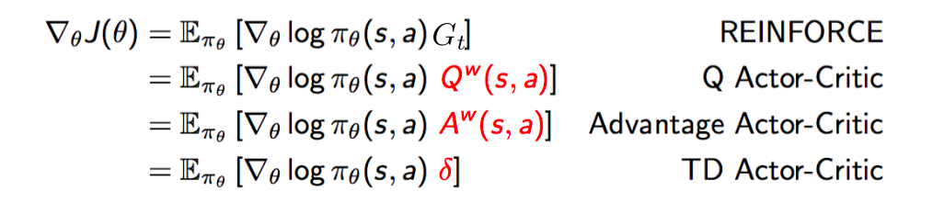
Equations for AC

Slide 15
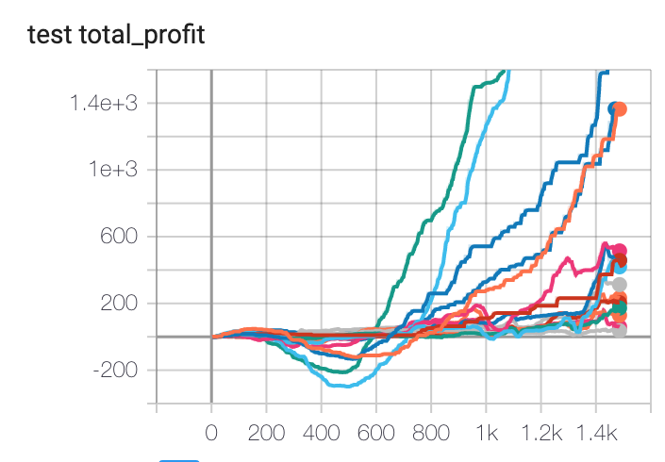
A2C Results

Slide 16
Trust Region Policy Optimization
Using TRPO to manage Stock Trading

Slide 17
TRPO
Environment
The Environment is a Custom Trading environment created using Stable baselines and Gym Env
Observation
Dataset Features (close, high, low, open, volume)
Action
Buy
Sell
The Environment is a stacked environment with 3 layers Training, Validation and Trading
Hold
Agent
Stock Ticker = Apple[‘Appl’]
Technical Indicators (macd, cci, dx, rsi)
Reward = asset value increased (Cumulative returns made in n-steps)

Slide 18
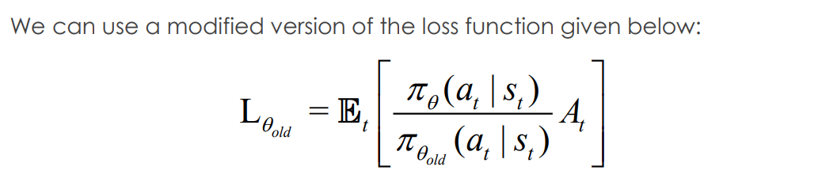
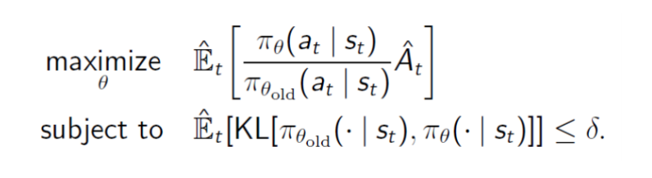
Equations for TRPO
The new formulation of the optimization with the trust region constraint is:

Slide 19
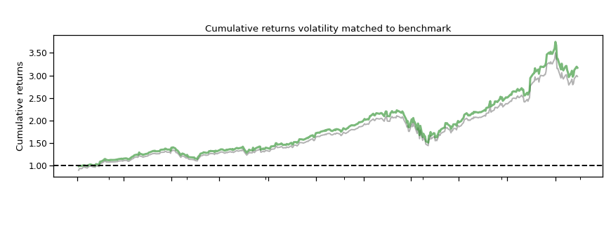
TRPO Performance output

Slide 20
Proximal Policy Optimization
Using PPO to carry out stock Trading

Slide 21
PPO
Environment
The Environment is a Custom Trading environment created using Stable baselines and Gym Env
Observation
Dataset Features (close, high, low, open, volume)
Action
Buy
Sell
The Environment is a stacked environment with 3 layers Training, Validation and Trading
Hold
Agent
Stock Ticker = Apple[‘Appl’]
Technical Indicators (macd, cci, dx, rsi)
Reward = asset value increased (Cumulative returns made in n-steps)

Slide 22
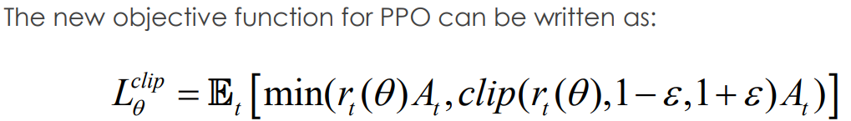
Equations for PPO
The Loss function for PPO is same as TRPO, replacing the gradient of the log of policy with the ratio of the new policy to the old policy

Slide 23
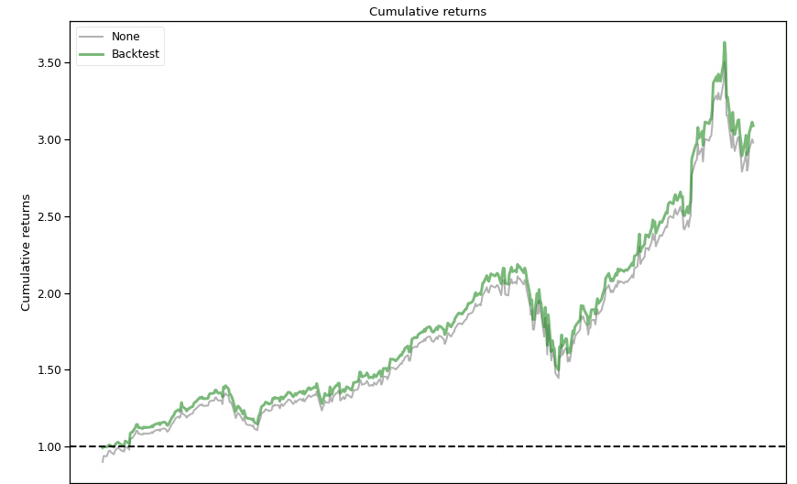
PPO Performance output

Slide 24
Demo and GitHub Link for the code
Github Link
Link: GPSV-Project/Reinforcement-Learning-Stock-Prediction: CMPE 297 sec 47 Project. (github.com)

Slide 25
Conclusion
Algorithm | Time to converge (Minutes) | Sharpe Ratio Metrics | Annual return | Stability
A2C | 2.44 | 2.29 | 78.81 | 0.915
PPO | 2.42 | 1.88 | 101.10 | 0.908
TRPO | 2.13 | 1.24 | 50.14 | 0.888
DQN | 120 | Not Applicable | Not applicable | Not Applicable
Hyperparameters Used |  | Hyperparameters
Learning rate = 0.0007 | Policy = ‘MlpPolicy’ | Time steps = 100000 | Entropy coefficient = 0.005
Beta (Discount factor) = 0.99 | N_steps = 128 | Minibatches = 4

Slide 26
Thank you
Questions?

Slide 27
References
https://medium.com/@kaijuneer/reinforcement-learning-for-stock-trading-agent-20d89a1a280a
https://github.com/llSourcell/Q-Learning-for-Trading
https://towardsdatascience.com/introduction-to-various-reinforcement-learning-algorithms-i-q-learning-sarsa-dqn-ddpg-72a5e0cb6287
https://towardsdatascience.com/deep-reinforcement-learning-for-automated-stock-trading-f1dad0126a02
https://www.mlq.ai/deep-reinforcement-learning-for-trading-with-tensorflow-2-0/
https://www.analyticsvidhya.com/blog/2020/10/reinforcement-learning-stock-price-prediction/

